Slide 1
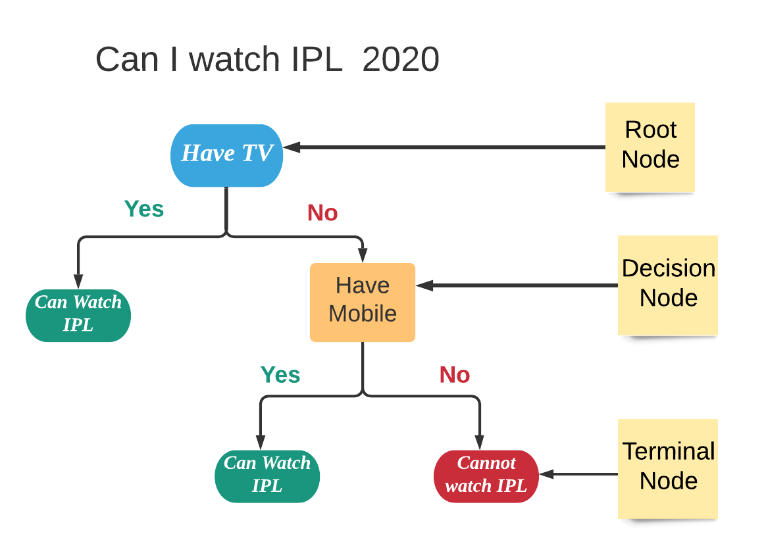
Decision Trees
Decision Trees is a model in which the the data is continuously split according to a certain parameter or condition

Slide 2
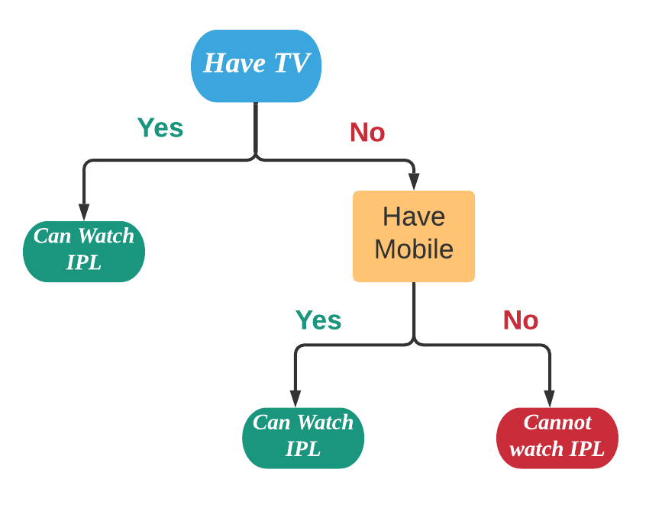
TV | Mobile | Watch IPL
Yes | No | Yes
Yes | Yes | Yes
No | Yes | Yes
No | No | No

Slide 3
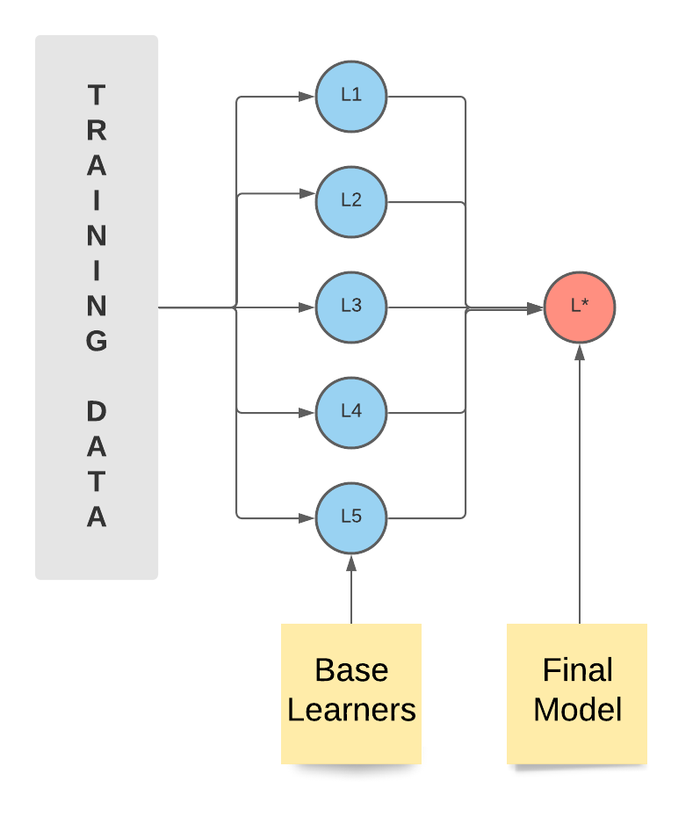
Ensemble Learning
Different Models
Different Training Dataset
Heterogeneous Learners
Weak learners

Slide 4
Bootstrapped Dataset
Derived from original dataset by randomly picking up values
Original Dataset
BootStrapped Dataset
 | A | B | C | T
1 |  |  |  | Yes
2 |  |  |  | No
3 |  |  |  | No
4 |  |  |  | Yes
 | A | B | C | T
4 |  |  |  | Yes
2 |  |  |  | No
1 |  |  |  | Yes
3 |  |  |  | No

Slide 5
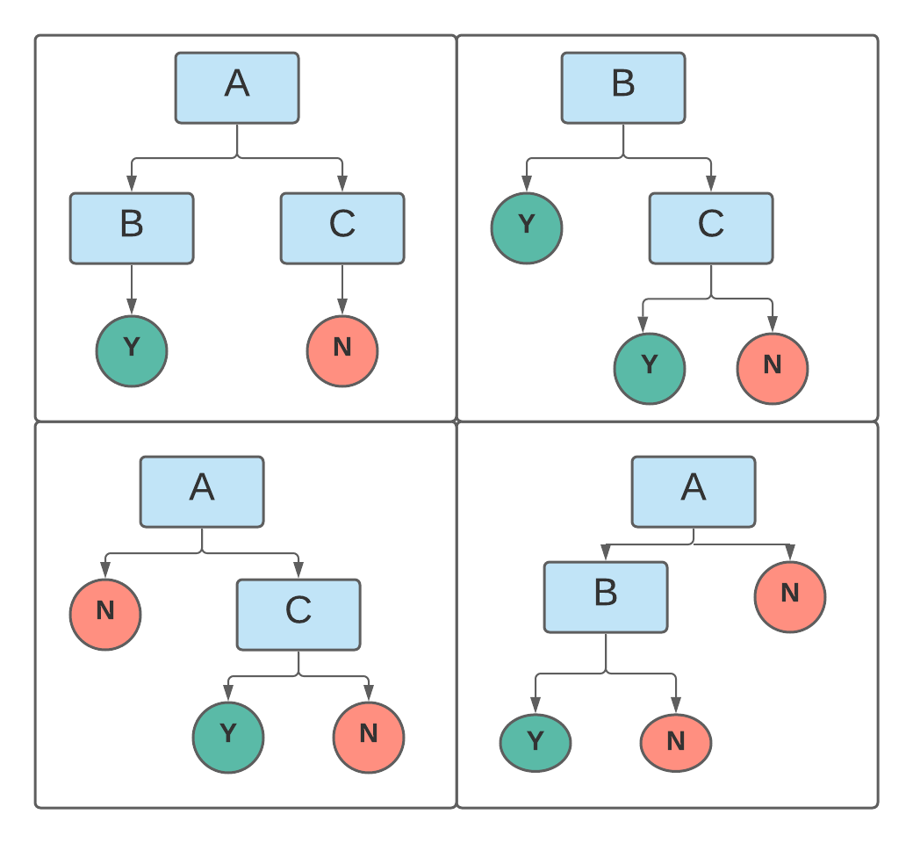
Building Decision Trees
BootStrapped Dataset
 | A | B | C | T
4 |  |  |  | Yes
2 |  |  |  | No
1 |  |  |  | Yes
3 |  |  |  | No

Slide 6
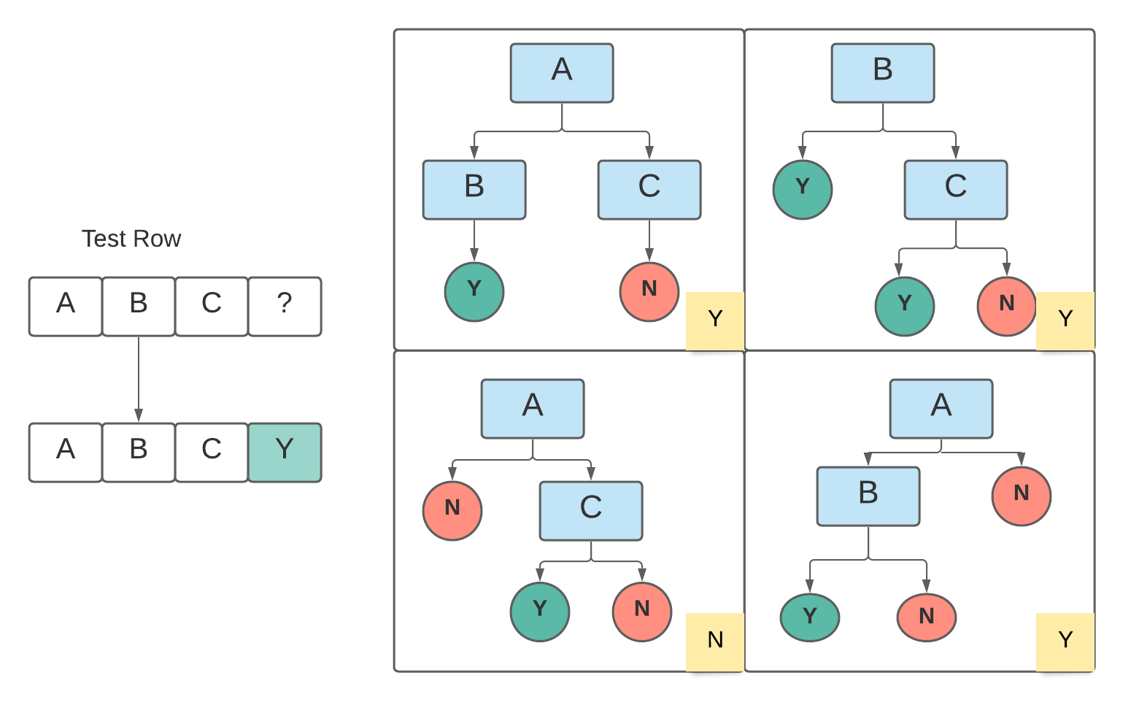
Voting Method

Slide 7
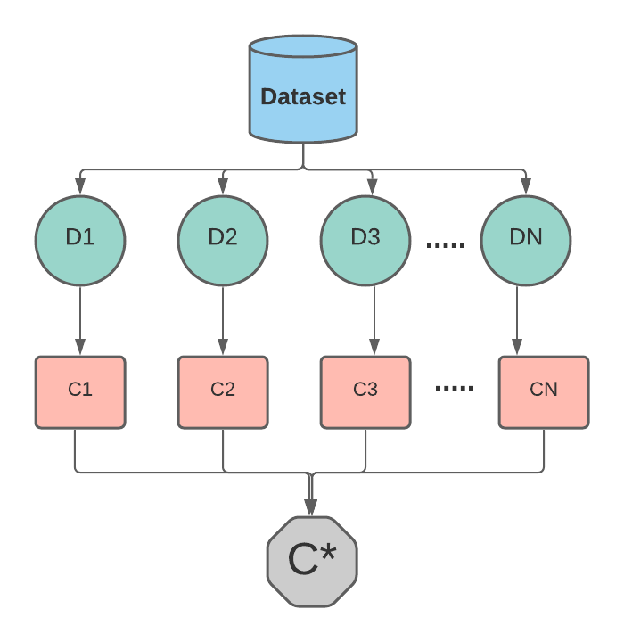
Bagging

